Slide 1
Career Service Application
By Team ProjectK for SOEN 6011

Slide 2
Team Members
Praful P. Nair, 40226483 (Team lead, Design, UI & Documentation)
Dikshant Yadav, 40221623 (Lead Developer, Design, UI, backend, CI/CD)
Himanshu Rathod, 40234325 (Developer, UI, Backend, Test team, CI/CD)
Tanay Srivastava, 40234148 (UI/UX, Documentation, Test team)
Revanth Velagandula, 40229629 (Test team, CI/CD setup)
Hema Reddy, 40236911 (Documentation, Team coordinator)

Slide 3
Acknowledgment
Professor. Joumana Dargham, Assistant Professor, Computer Science and Software Engineering, Concordia University.
Thank you for your valuable guidance and mentorship throughout our project. Your insights have been invaluable in shaping our work.
Notes:
We would like to thank the professor for her continued support throughout this course, we felt it was valuable while we developed this project

Slide 4
Introduction
This project introduces a comprehensive web-based career service platform.
It caters to students, job seekers, and employers, facilitating job matching and recruitment processes.
Users can interact with the platform to post jobs, shortlist candidates, and manage resumes.
Accessible via web interface, requiring a PC and internet connection.
Notes:
We developed a career service web application, where students can find jobs for themselves, and recruiters can easily post jobs for their organizations. This application carter to three user groups - the students / the jobseekers, recruiters or employers and admin users who can manage this application For this application, we would need a laptop or pc with internet.

Slide 5
Project Overview
The system uses the Model-View-Controller architecture
This architecture separate presentation and interaction from the system data.
The codebase is maintained in a GitHub repository, along with documentations pertaining to minutes of meeting, user stories, task breakdowns, risks and mitigation, tests documents etc.
Notes:
We have developed this project keeping in mind the model-view -controller architecture, as it allows us to separate presentation and interaction from the system data.
All our work, the codebase, is maintained in a github repo, along with all the documentations pertaining to user stories, task breakdown, risk, mitigation, and test documents

Slide 6
For Students
Experience a user-centric, minimal interface that empowers students and job seekers with unparalleled opportunities.
Seamlessly browse through an extensive array of curated job listings, applying for roles that resonate with their aspirations.
Simple, efficient application process
View jobs, apply them within few clicks.
Elevate personal profile by creating a comprehensive profiles and uploading tailored resumes, presenting a holistic representation of skills and accomplishments.

Slide 7
For Recruiters
Empower recruiters with an intuitive and efficient platform to streamline their talent acquisition process.
With effortless precision, employers can effortlessly draft and broadcast job listings, tapping into a pool of exceptional candidates.
This innovative tool further allows employers to meticulously assess applicants, shortlisting prospects tailored to their specific requirements.

Slide 8
For Admins
System admins can easily manage user profiles
They can review profiles and delete inactive recruiter profiles, or misleading job posting etc.
The platform provides an overview of all members, and the data associated with them like student resume, job ads etc.

Slide 9
Methodology
We have followed Agile development process while developing this system
The work is done within 4 sprints
Team members often reviewed each others work and filled in roles flexibly
We encouraged to conduct frequent meetings in between each sprint either offline or online
We prioritize user stories to work in each sprint and focused on high priority tasks first.
We had working delivery for each sprint

Slide 10
Technology Stack
Python 3
Flask
HTML5
CSS
JavaScript

Slide 11
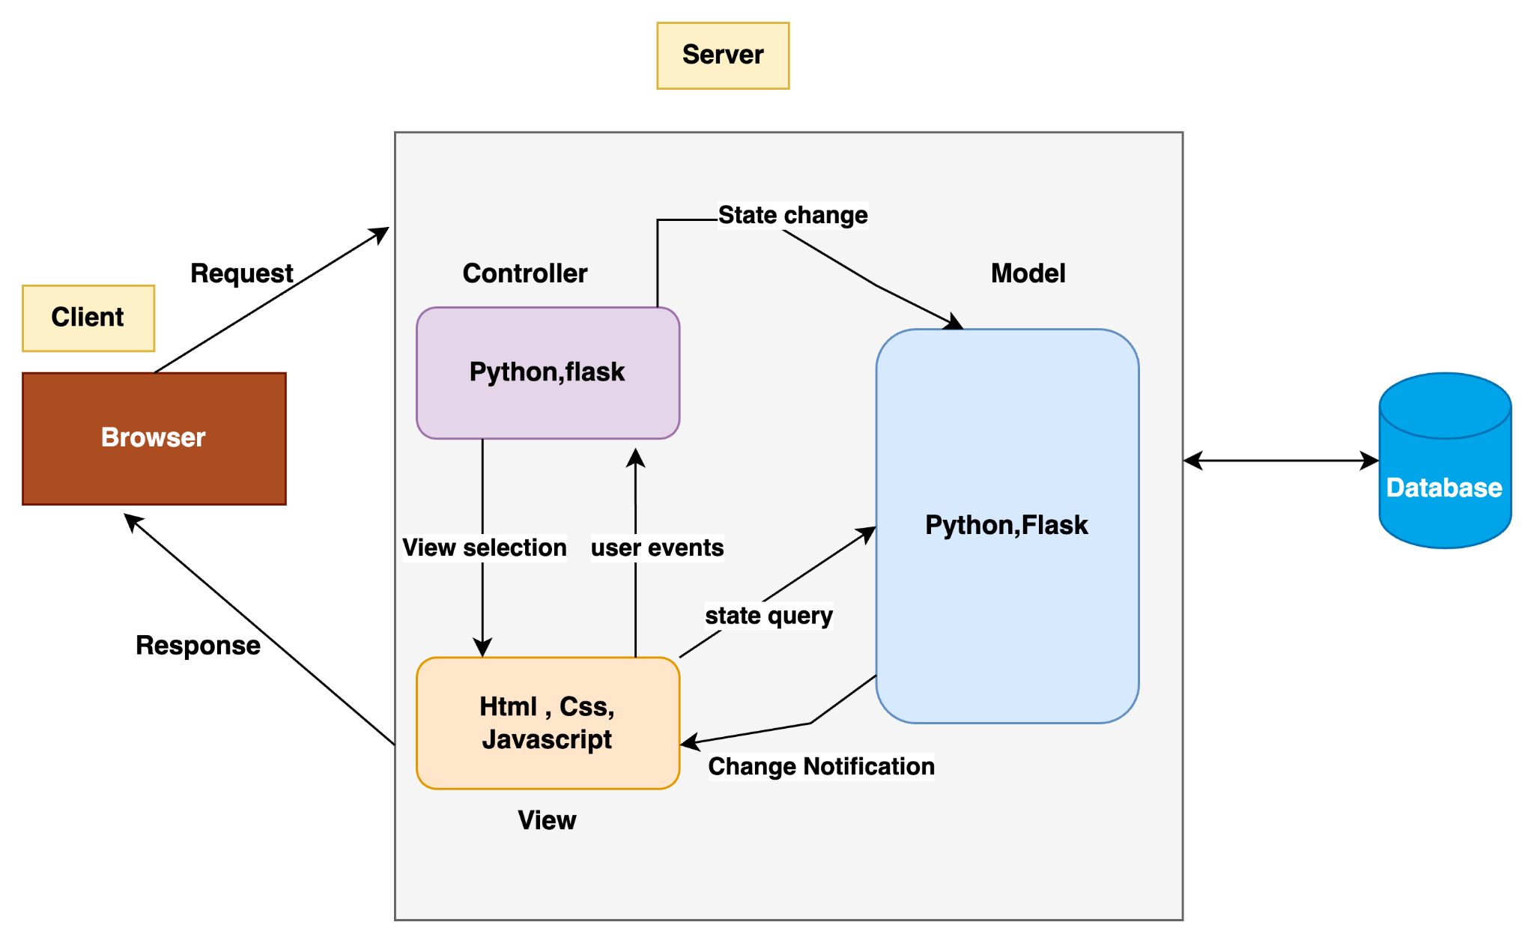
Model-View-Controller Architecture

Slide 12
Testing
We created test suites for each of the user stories
Unit tests were written for modules to validate individual components
Testing has been done to ensure
Reliability of the platform
User satisfaction
Functionality consistency
Continuous improvement

Slide 13
Unit Testing
We have done testing for:
Login and SignUp,
Post Job module,
Apply Job module ,
Show all Users for admin,
Delete Job feature
Delete User feature
Student profile creation
Select student for interview

Slide 14
Continuous Integration and continuous delivery
We have used GitHub Action to set up a pipeline for testing and continuous integration
This involves setting up workflow using YAML files
The workflow setup is triggered on actions like code push or pull requests
We have to set this up with appropriate dependencies and libraries to ensure correct working
GitHub Actions ensures each workflow run operates in an isolated environment, preventing interference between different tests

Slide 15
Demo

Slide 16
Conclusion
The team successfully developed a career service application catering to the needs of jobseekers, students and recruiters.
We successfully learned and applied agile principles in this development.
We have correctly documented all the required artifacts like Epics, user stories, task breakdown, its risks, probability, impact and countermeasures.
The application was successfully collaborated and developed on github.
We have made timely deliveries for each of the Sprints.

